Slide 1
Predicting Outcomes of Prostate Cancer Immunotherapy by Personalized Mathematical Models
Taylor Beverly, Jayla Driver, Anisah Thomas

Slide 2
Main Question
How can we use math modeling to improve therapeutic vaccination against disseminated prostate cancer (PCa)? How can this method be enhanced to provide a more individualized treatment for patients?

Slide 3
Background and Motivation
Prostate cancer (PCa) is the second most common cancer in men
Treatment includes removal of the prostate and/or radiation
If prostate-specific antigen (PSA) increases after therapy, that indicates the activation of cancer controlled by androgen deprivation
PSA levels can rise while being asymptomatic, but if the qua]lity of life decreases, treatment begins
This study tests the efficacy of immunotherapy
To test this, researchers measured changes in PSA levels in order to correlate a tumor burden
This model helps to personalize treatment and improve a vaccine

Slide 4
Summary
Researchers wanted to find a more tailored approach to treat disseminated prostate cancer (PCa) with therapeutic vaccination
They developed a math model with iterations of the vaccine immune to PCa cells and validated their results with testing of an allogenic PCa whole cell vaccine
They measured the changes in PSA levels to correlate tumor burden
Researchers tested 26 levels per patient and compared their initial PSA levels and the validation set in order to personalize the model and predict changes
The model was accurate for 12 of 15 patients (3 being unresponsive)
Each model was simulated with various treatment methods in order to find the best treatment method and personalized regimens

Slide 5
Biological Aspects
Key Aspects:
Prostate-Specific Antigen Levels (PSA)
Protein produced by cells making up the prostate gland
Tumor Vaccination
Immunotherapy treatment to attack and eventually destroy the tumor
PCa
Prostate Cancer
Dendritic Cells
Immune cells that boosts immunoresponses

Slide 6
Authors’ Techniques for Problem Solving
The Problem: Modeling the dissemination rate of Prostate Cancer cells after vaccination therapy
Utilized the results of a clinical trial to validate results
Determining Factor: Prostate-Specific Antigen Levels (PSA)
Developed a model showing the time-dependent relationships between PSA and the vaccine
Developed a general mathematical model (7 ODEs)
Took into account time-dependent immune stimulation and immune suppression
Tested if the model could formulate accurate PSA levels
Used PSA levels measured before and during the initial five to nine treatment cycles as validation which individualized the model for each patient
Notes:
The results consist of looking at PSA levels
PSA levels associated with tuer burden
Individualize - meaning using the real data to personalize the model to each patient

Slide 7
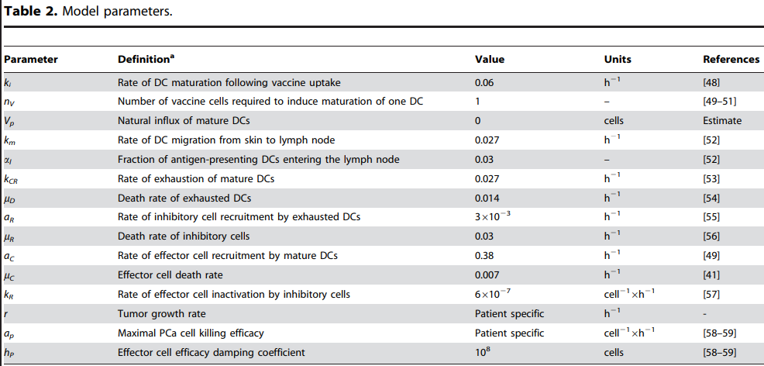
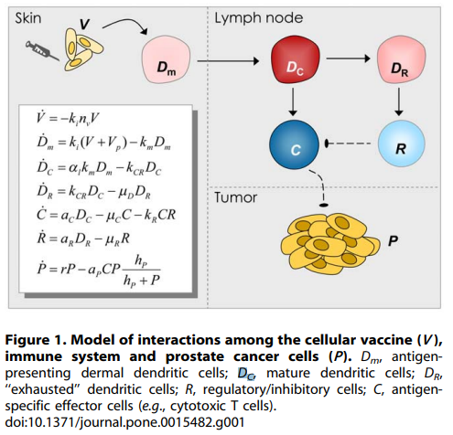
ODE Breakdown
Table 2: Lists the terms and provides definitions of each term within the 7 ODEs
Notes:
DCs - A special type of immune cell that is found in tissues, such as the skin, and boosts immune responses by showing antigens on its surface to other cells of the immune system

Slide 8
Replication:
2 Patient Observation
Patients 18 and 21

Slide 9
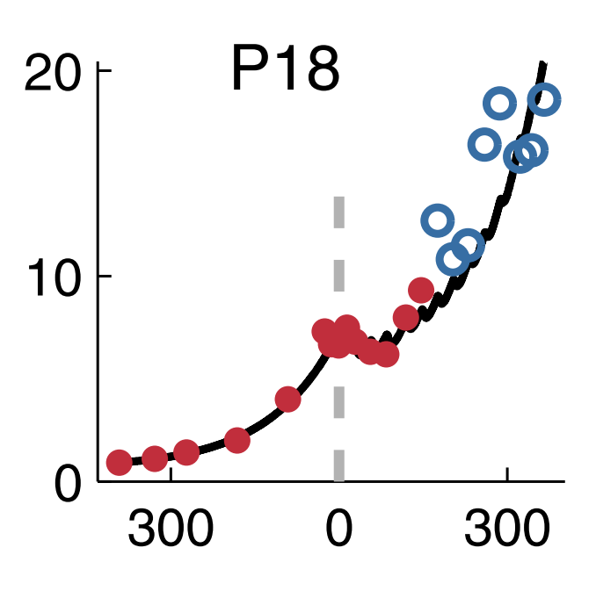
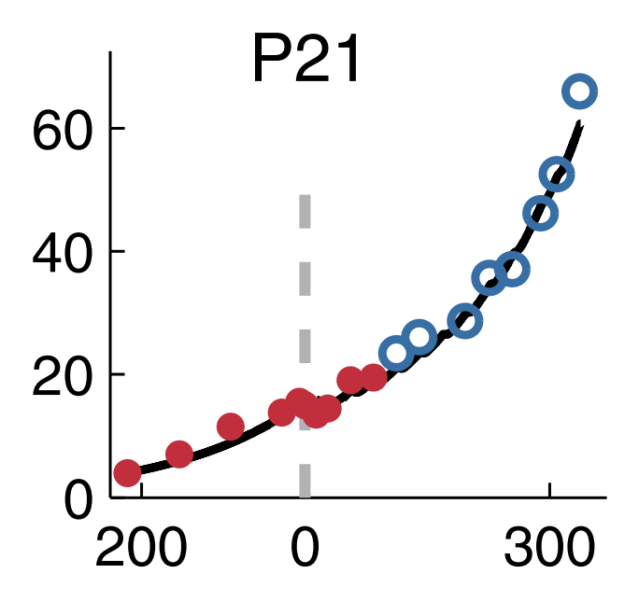
Initial PSA Levels looking at Patients 18 and 21
PSA (ng/mL)
Time (days)
Notes:
Validation of individualized models for patients responding to vaccination -
Red dots: Patient-specific best-fit model parameters were derived by fitting the model to the respective pretreatment PSA values and the initial in-treatment PSA values.
Blue dots:Subsequent PSA levels were predicted by the use of the obtained best-fit parameters.
vertical dashed lines indicate the beginning of vaccination treatment on day 0.

Slide 10
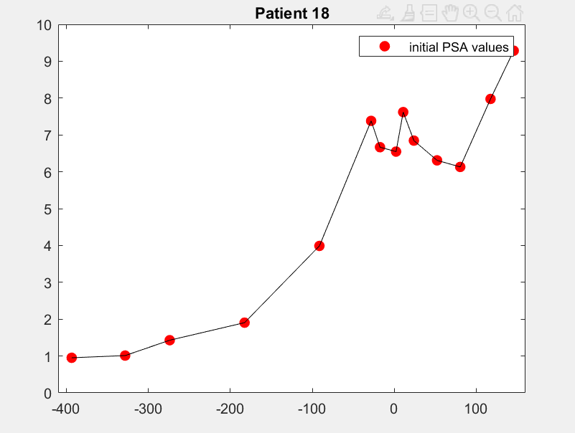
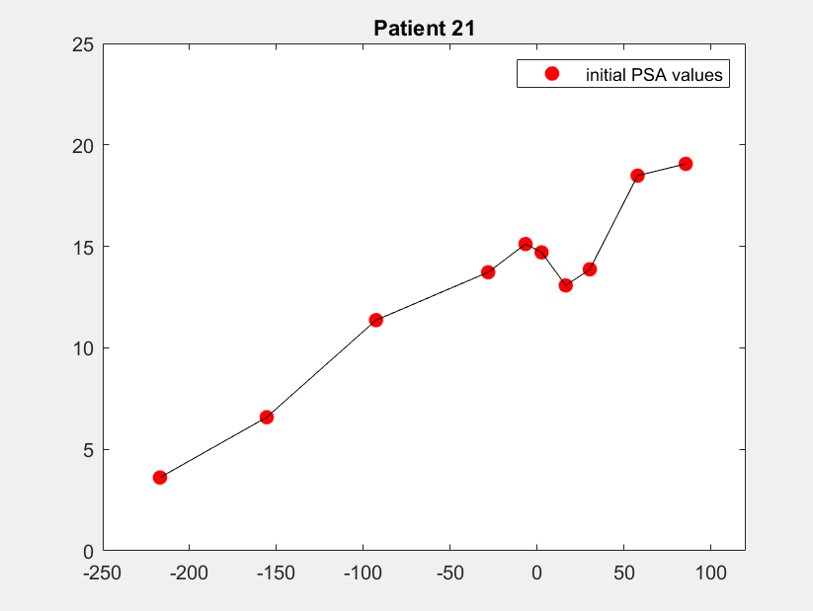
Matlab Plots of Initial PSA levels
PSA (ng/mL)
PSA (ng/mL)
Time (days)
Time (days)

Slide 11
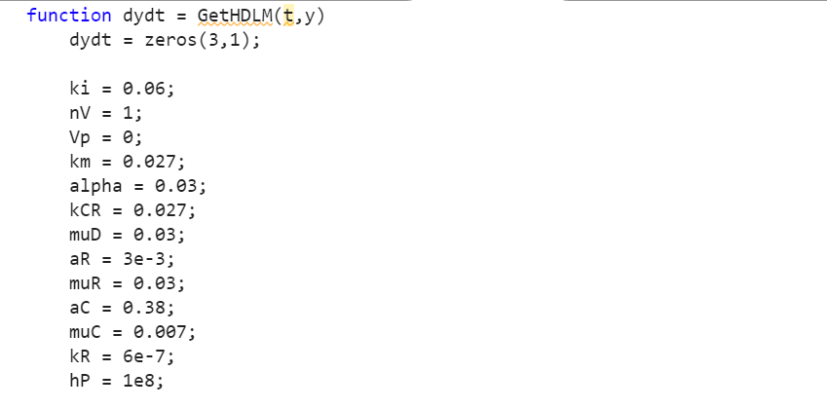
Code that Duplicates Paper’s Results

Slide 12
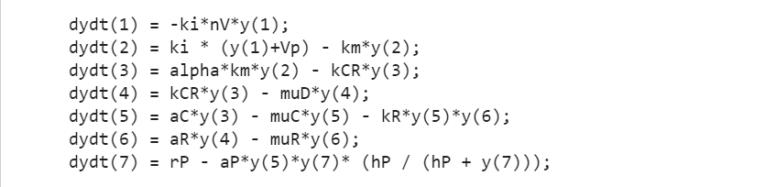
Coded Seven ODEs
Notes:
r and aP parameters - unable to be found

Slide 13
Patient Comparison
Patient 18
Given a single dose every 28 days
Given a double dose every 28 days
Given single dose every 28 days
Given single dose every 21 days
Patient 21
Given a single dose every 28 days
Given a triple dose every 28 days
Given single dose every 28 days
Given single dose every 14 days
Notes:
Figure 5

Slide 14
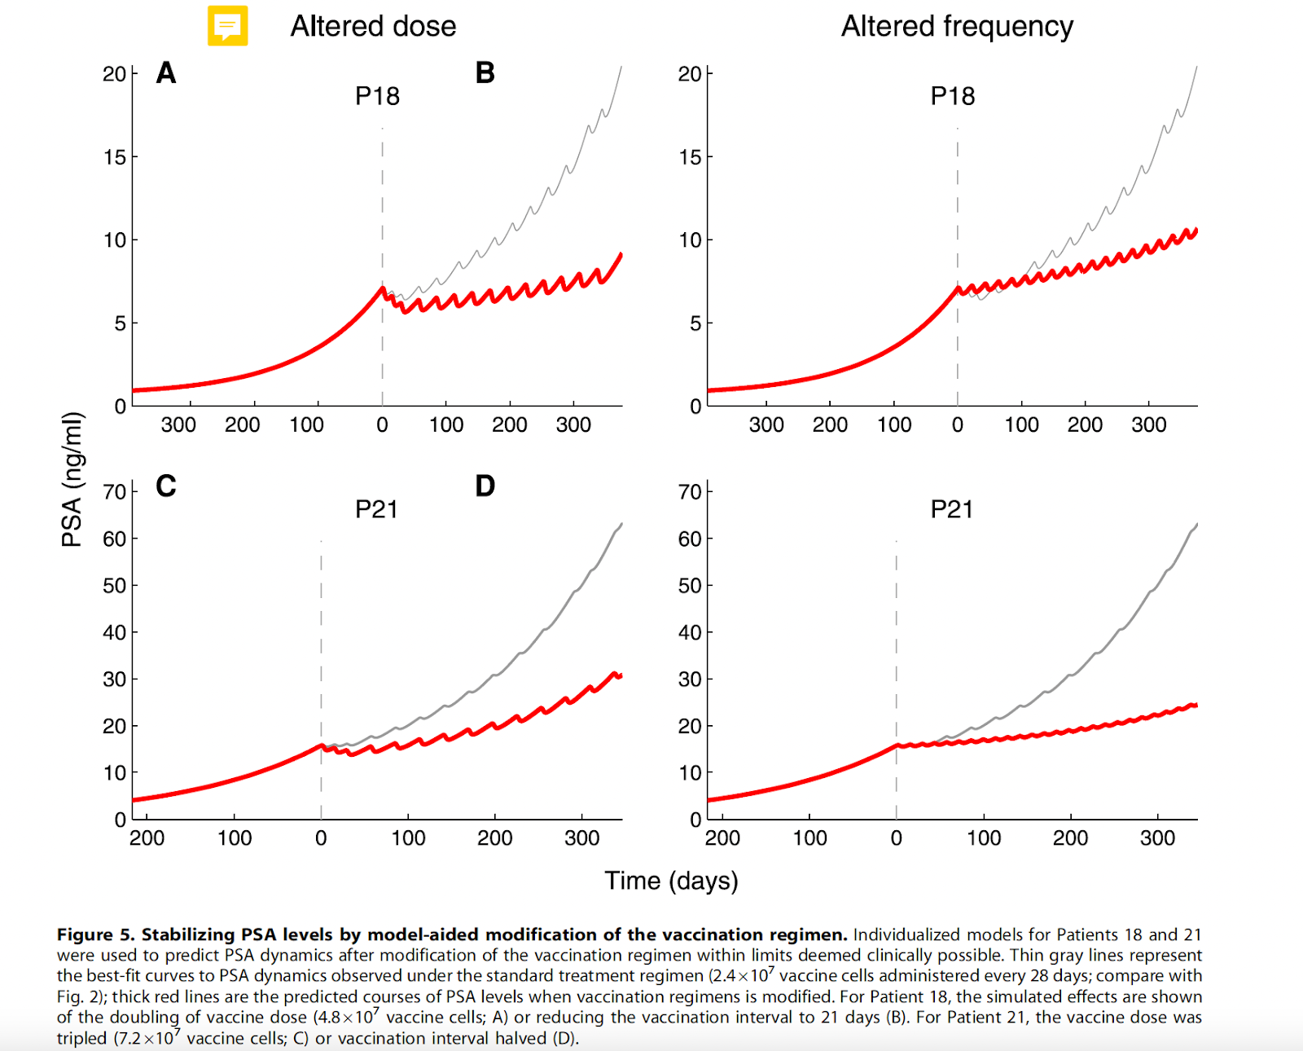
Paper Generated Results
Notes:
Grey - best-fit curves to PSA dynamics under standard treatment (2.4e7 cells / 28 days)
Red - predicted courses of PSA levels when vaccine regimens is modified

Slide 15
Results and Conclusion
Used actual PSA levels from a clinical trial to personalize and validate the mathematical model
15 vaccination-responsive patients
The model accurately modeled the PSA level changes of 12 out of the 15 vaccine-response
3 of the 15 vaccine-response patients PSA levels could not be predicted due to their inconsistent changes
By utilizing this model, we can predict more effective dosages of the vaccine relative to a specific person to maximize tumor destruction

